Slide 1
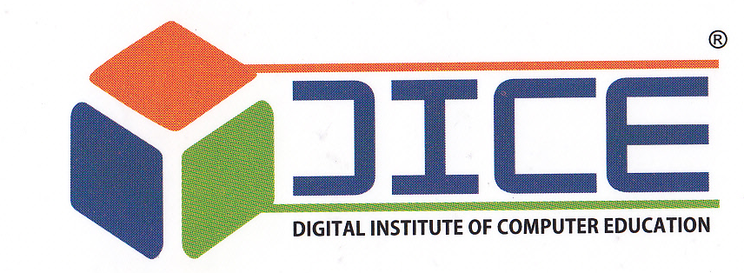


Slide 2
COURSES OFFERED BY DICE
C.C.C. - Course on Computer Concept
D.T.P. - Desktop Publication
C.T.T. - Computer Teacher Training
A.C.C. - AutoCAD Course
D.C.A - Diploma in Computer Application
A.D.C.A -Advance Diploma in Computer Application
P.G.D.C.A - Post Grad. Diploma in Comp. Application
D.I.T. -Diploma in Information Technology
D.W.D - Diploma in Web Designing.
D.M.A. - Diploma in Multimedia Animation
A.D.M.A - Advance Diploma in Multimedia Animation
VFX -Diploma in 3D Animation and VFX
D.A.F.A. - Diploma in Advance Financial Accounts
D.S.D - Diploma in Software Development
M.S.O -Ms – Office
C.A.C.S -Certificate in Advance Computer Software
D.B.T -Diploma in Beautician Training
D.C.T. - Diploma in Cutting and Tailoring.
D.F.D. - Diploma in Fashion Designing

Slide 3
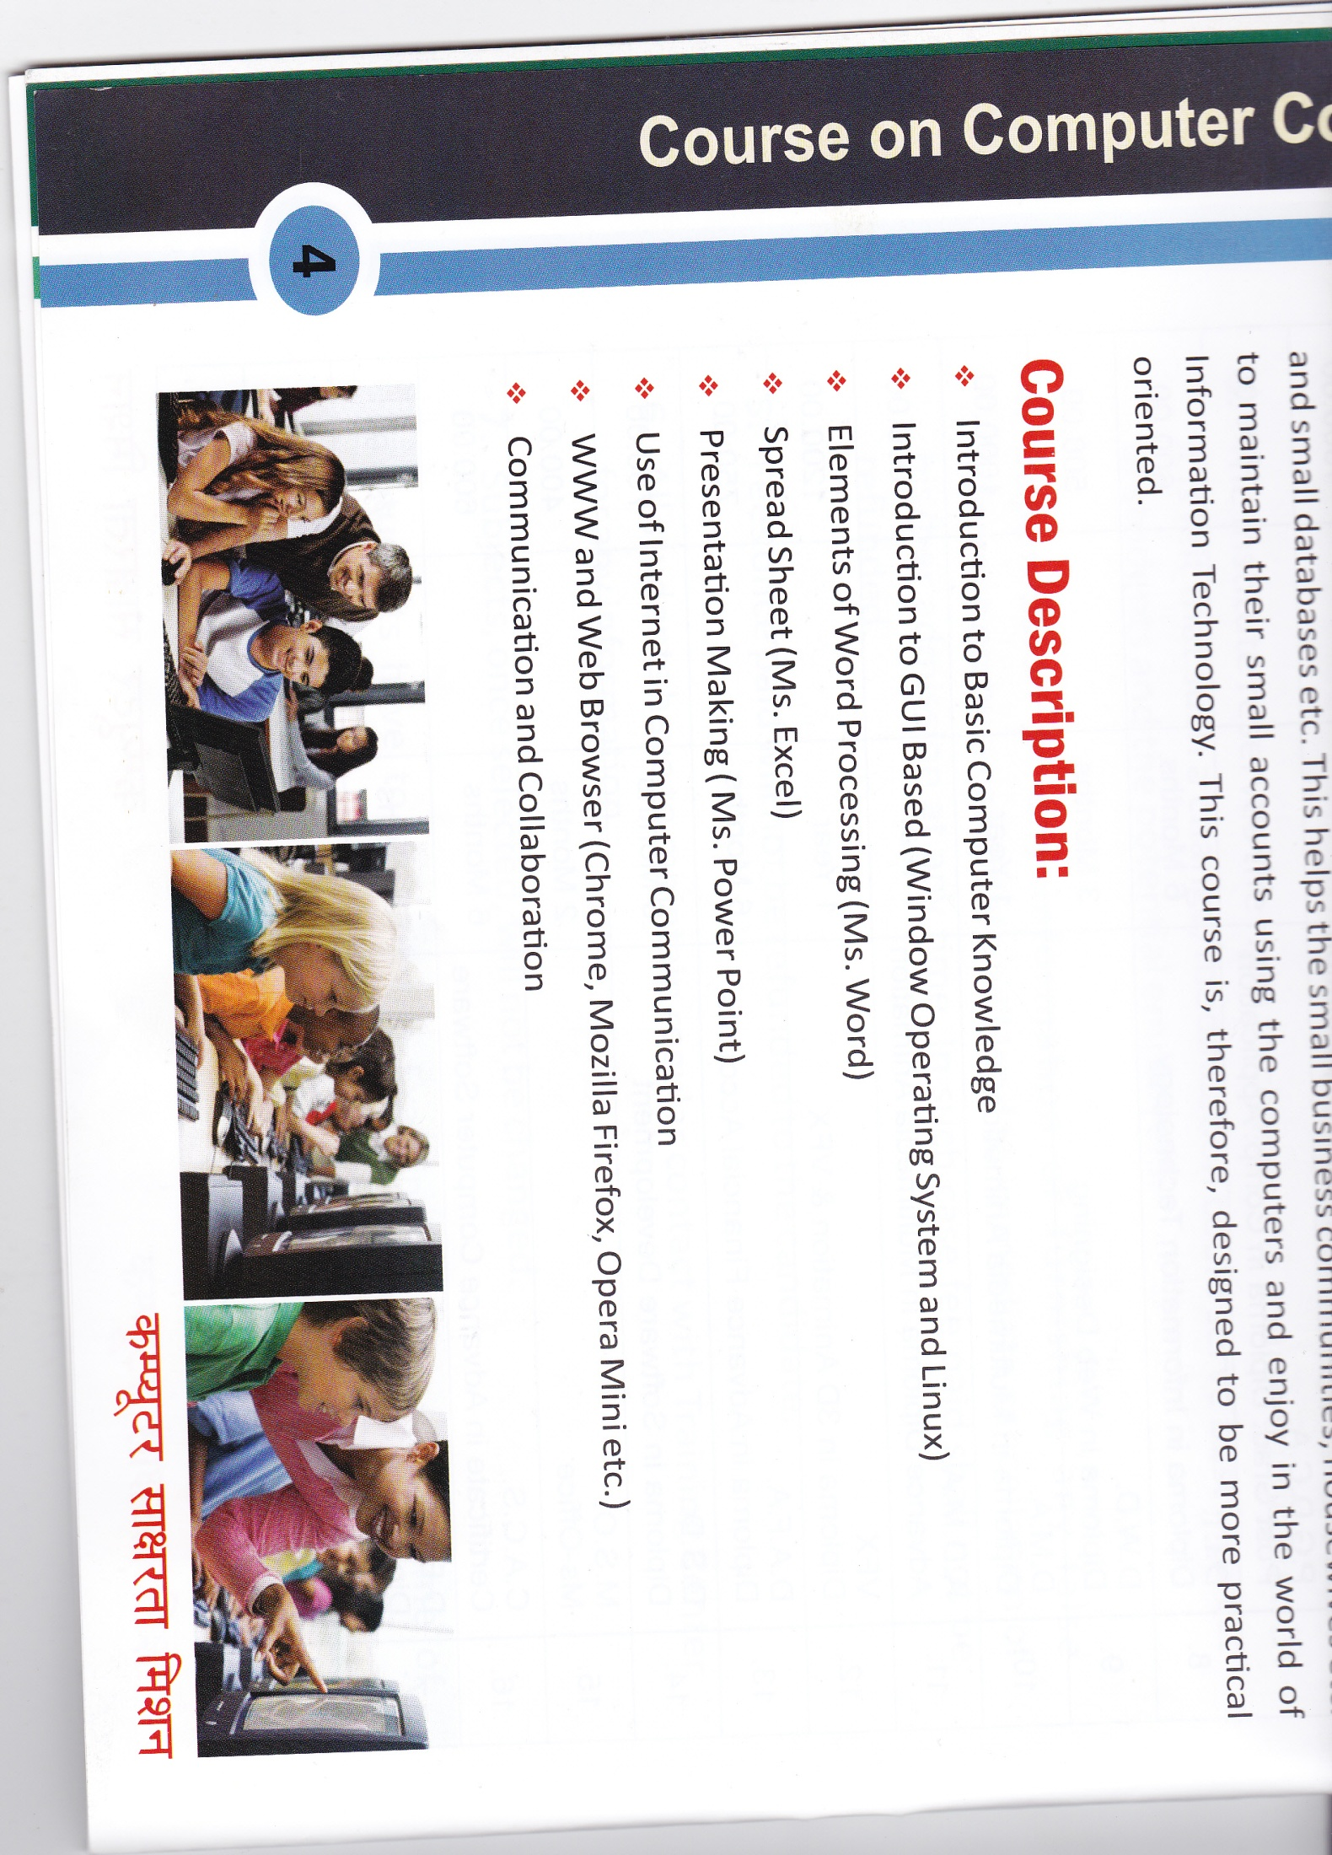
COURSE CODE - CCC
This course is designed to aim at imparting a basic level IT Literacy programme for the common man. This programme has essentially been conceived with an idea of giving an opportunity to the common man to attain computer literacy thereby completing the course the incumbent should be able to use the computer for basic purpose of preparing ones personal/business letters, viewing information on internet (the web), receiving and sending mails, preparing business presentations and small database etc. This helps the small business communities, housewives etc. to maintain their small accounts using the computers and enjoy in the world of Information Technology. This course is, therefore, designed to be more practical oriented.
COURSE DESCRIPTION :
Introduction to Basic Computer Knowledge
Introduction to GUI Based (Window Operating System and Linux)
Elements of Word Processing (Ms. Word)
Spread Sheet (Ms. Excel)
Presentation Making (Ms. Power Point)
Use of Internet in Computer Communication
WWW and Web Browser (Chrome, Mozilla Firefox, Opera Mini etc.)
Communication and Collaboration

Slide 4
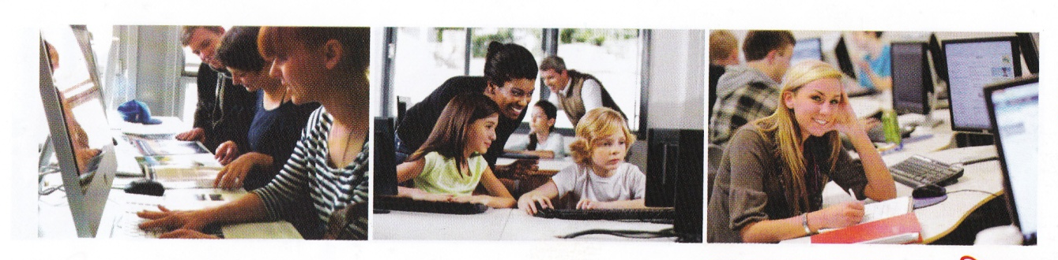
COURSE CODE : DTP
We Provide computer education for DTP and other Computer courses with considerable quality and perfection. DTP course is useful for leaning how to design various publication such as banner, brochure, visiting cards, books and book covers, booklets, kankotri etc. DTP course includes PageMaker, CorelDraw and Photoshop. This course is useful for graphic designer, web designers, DTP operators and all other persons who work with images and designs. Following are the topics which you will learn during this course.
COURSE DESCRIPTION :
Computer Concepts and Fundamental (With Introduction to Internet and E-mail)
Knowledge of Operating System
Adobe Page Maker
CorelDraw
Adobe Photoshop

Slide 5
COURSE CODE - CTT
The Computer Teacher Training Course (CTT) is aimed for those who want to make their career in Teaching and Training Sector. The Computer Teacher Training Course (CTT) program prepares the learners for a specialized career in Teaching and Training field. The contents are designed in such a way that it not only provides the learner computer knowledge but also guides how to transfer this knowledge to students effectively.
COURSE DESCRIPTION :
Fundamentals of Computer and OS (Operating System)
Ms-Office (Ms-Word, Ms-Excel, Ms-Power Point, Ms-Access)
Internet and Web Browsing (HTML)
DTP (Adobe Page Maker, Adobe Photoshop, CorelDraw)
Computer Programming (C, C++ Language)
Java
Project

Slide 6
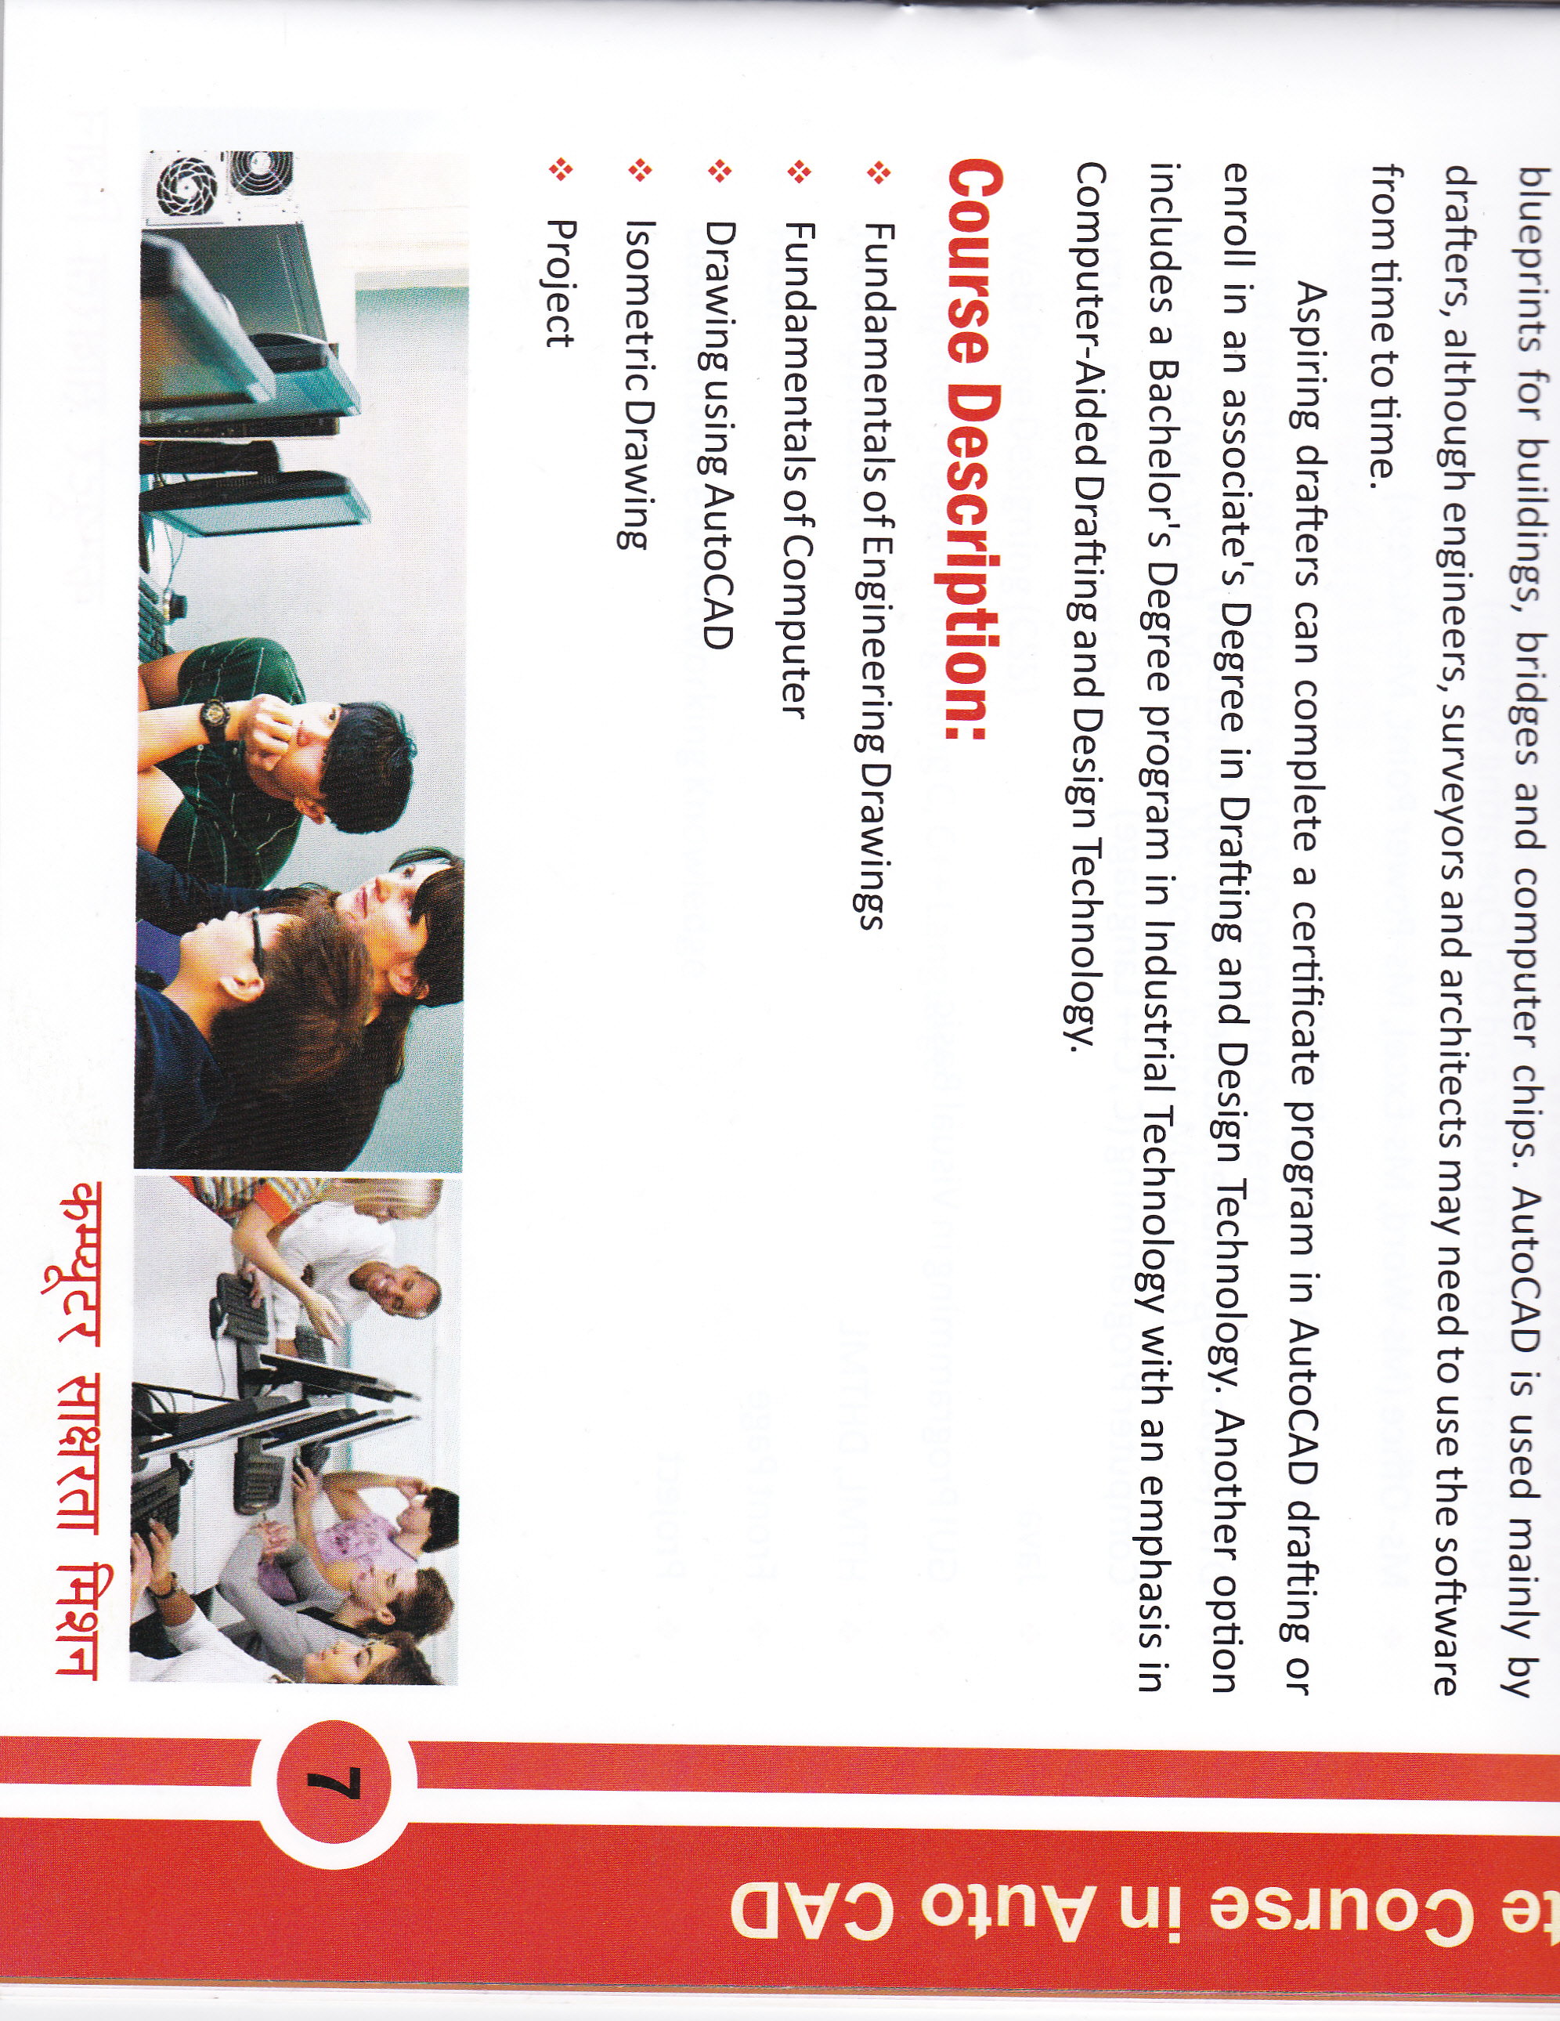
COURSE CODE : ACC
AutoCAD is a computer software which is mainly used in Civil, Mechanical, Electrical and Architecture Trade. Architects, Interior Designers and other Engineers take help of this Software to draw 2D and 3D drawings or models. The term AutoCAD Drafters is commonly used for Professional who use AutoCAD Software. We are offering training in advanced AutoCAD Courses for all the Candidates who are willing to create advanced drafting and elevations using AutoCAD’s 2D and 3D capabilities.
COURSE DESCRIPTION :
Fundamentals of Engineering Drawings
Fundamentals of Computer
Drawing using AutoCAD
Isometric Drawing
Project

Slide 7
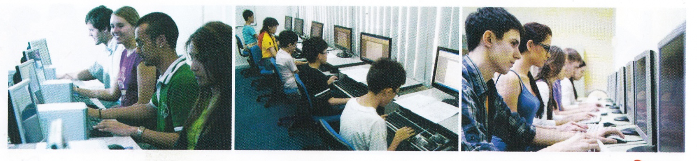
COURSE CODE : DCA
The Objective of this programme is to develop professionals to meet the requirement of office automation and electronic data processing. Different application software are introduced to understand the practical usage as well as specific work areas of computers. DCA is designed to build a strong foundation in programming, using object oriented programming languages like Java and C++. It helps to develop skills in web page designing using HTML and JavaScript.
COURSE DESCRIPTION :
Fundamentals of Computer and OS (Operating System)
Ms-Office (Ms-Word, Ms-Excel, Ms-Power Point, Ms-Access)
Internet & Web Browsing (HTML)
DTP (Adobe Page Maker, Adobe Photoshop, CorelDraw)
Computer Programming (C, C++ Language)
Java
GUI Programming in Visual Basic
HTML, DHTML
Front Page
Project

Slide 8
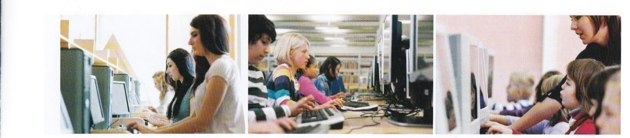
COURSE CODE : ADCA
With the growing demand of computers and the role it plays in our life, more and more skilled professionals are required to take care of the finer points. With new innovations in this area there is a growing demand for computer professionals with a sound understanding of basic computer applications in business covering key programming languages, data base management, system analysis, computer software development in specific applications such as studies, financial management and long range planning.
COURSE DESCRIPTION :
Fundamentals of Computer and OS (Operating System)
Ms-Office (Ms-Word, Ms-Excel, Ms-Power Point, Ms-Access)
HTML, DHTML and Front Page
Web Page Designing (CSS)
Computer Programming using C, C++ Language
JAVA Application
Flash
Basic Hardware and Networking Knowledge

Slide 9
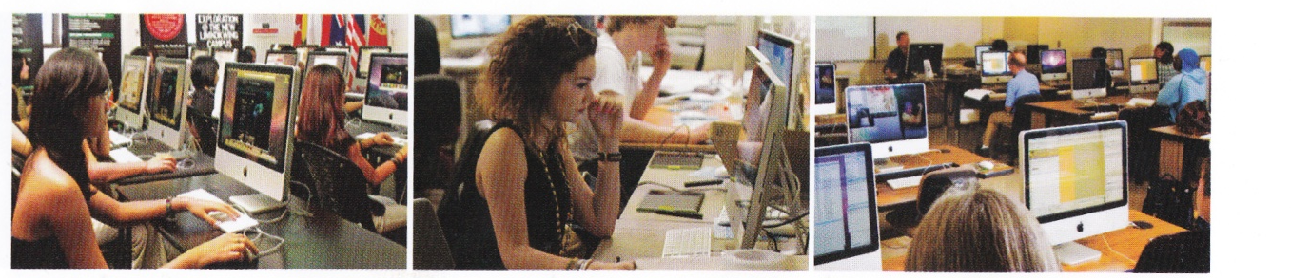
COURSE CODE : PGDCA
Information Technology and Computer Applications are refused to anything related to computing technology, such as networking, hardware, software, the internet, or the people that work with these technologies. Many companies now have IT departments for managing the computers, networks, and other technical areas of their business. IT jobs include computer programming, network administration, computer engineering, Web development, technical support, and many other related occupations. Since we live in the information age, information technology has become a part of our everyday life.
COURSE DESCRIPTION :
Fundamentals of Computer and OS (Operating System)
Ms-Office (Ms-Word, Ms-Excel, Ms-Power Point, Ms-Access)
Internet and Web Browsing (HTML)
DTP (Adobe Page Maker, Adobe Photoshop, CorelDraw
Computer Programming (C, C++ Language)
Java, .Net
HTML, DHTML, Front Page
Programming with Visual Basic, .Net
Computer Networks, Internet and Scripting.
Introduction to E-Commerce
Project

Slide 10
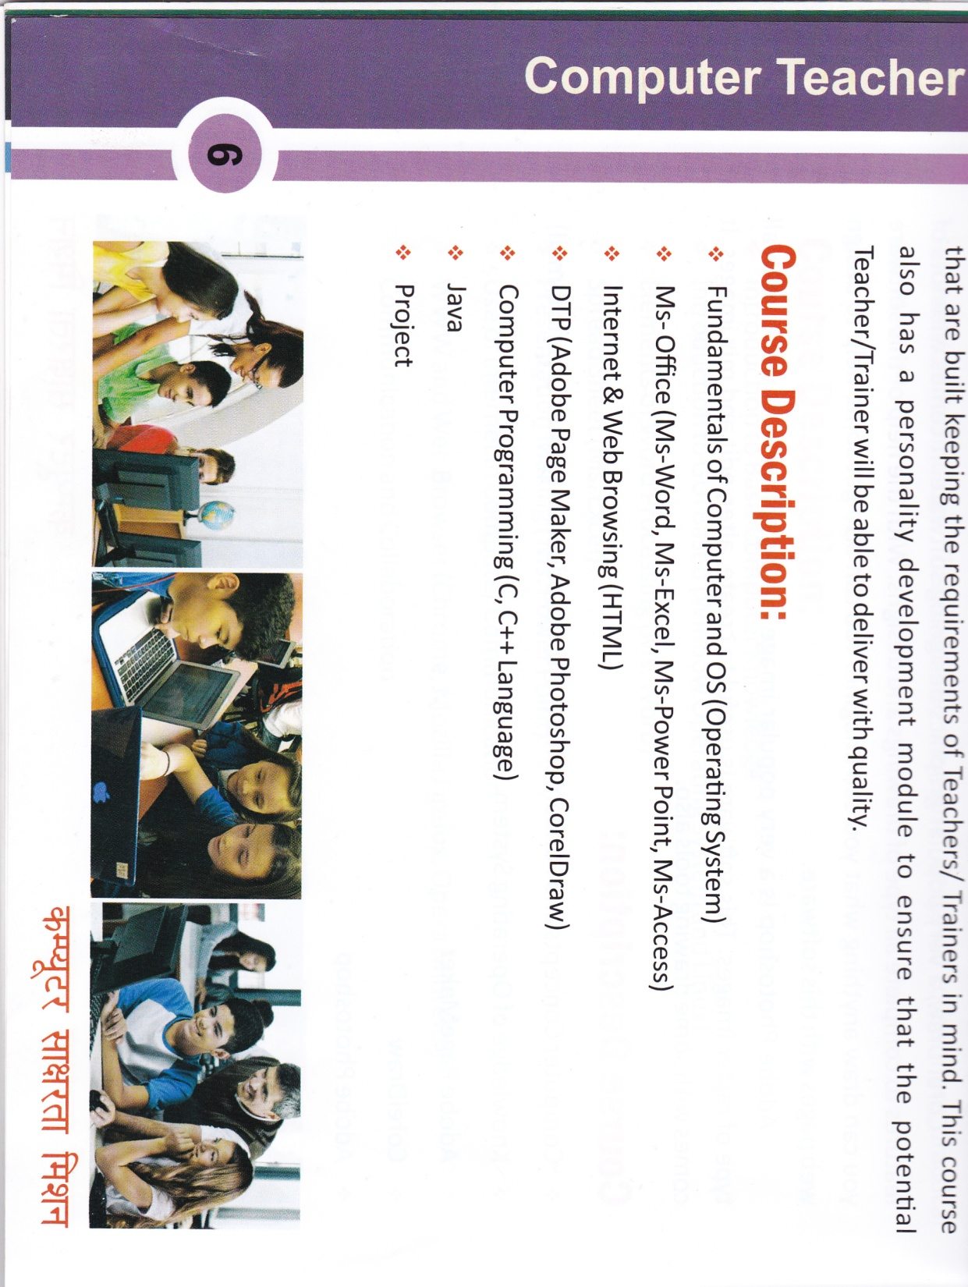
COURSE CODE : DIT
The Diploma in Information Technology is a one year programme designed to equip the students with the knowledge of operating system, e-commerce,Internet and other fundamental concepts so that it can help the students to enhance their career in this direction.
This course has been designed not only to emphasize on the academic theories and the practical application of computer science, but also to take into consideration the future development of the computer science discipline. It therefore,covers most aspects of Information Technology, System analysis and Software developments.
COURSE DESCRIPTION :
Fundamentals of Computer and OS (Operating System)
Adobe PageMaker
CorelDraw
Adobe Photoshop
Computer Programming using C, C++ Language
Web Page Designing (HTML, CSS)
Flash

Slide 11
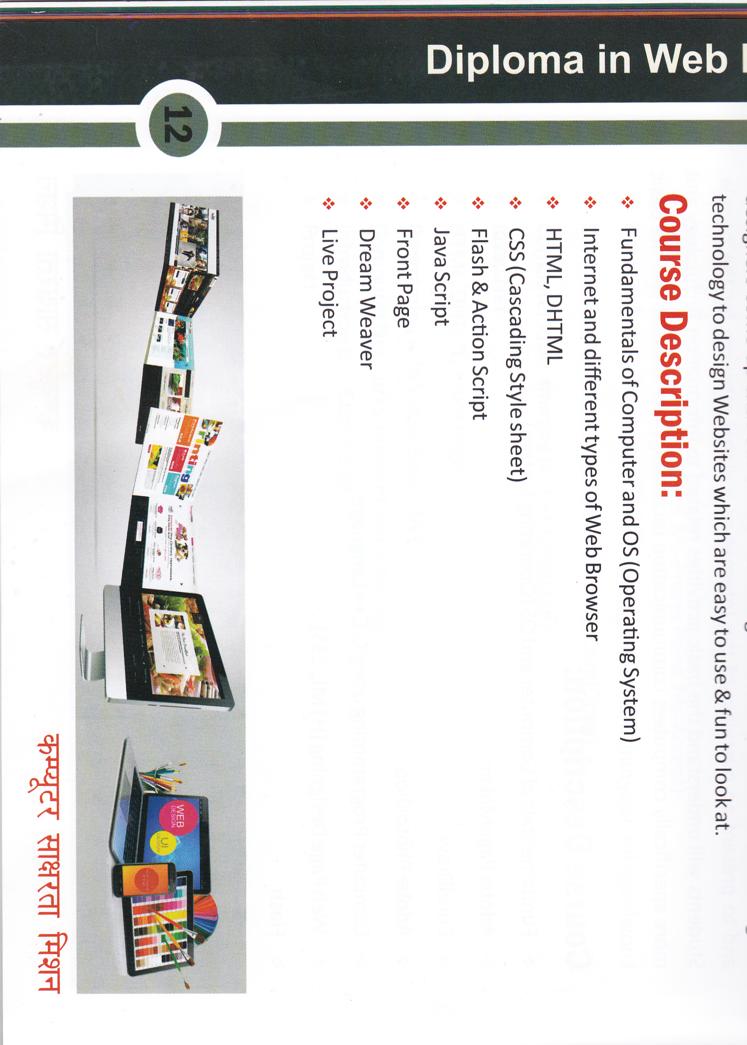
COURSE CODE : DWD
Web design is an essential part of everyone may be in any form as social media, entertainment and downloading things for educational purpose in the form of a website. So web designing course gives the real picture of yourself so everybody can get good knowledge about our product or business. Everyone wants a good website and he needs the best website designer to create a website for publicity and this web designing course helps them to create an appropriate website design with designing course.
COURSE DESCRIPTION:
Fundamentals of Computer and OS (Operating System)
Internet and different types of Web Browser
HTML, DHTML
CSS (Cascading Style Sheet)
Flash and Action Script
Java Script
Front Page
Dream Weaver
Live Project

Slide 12
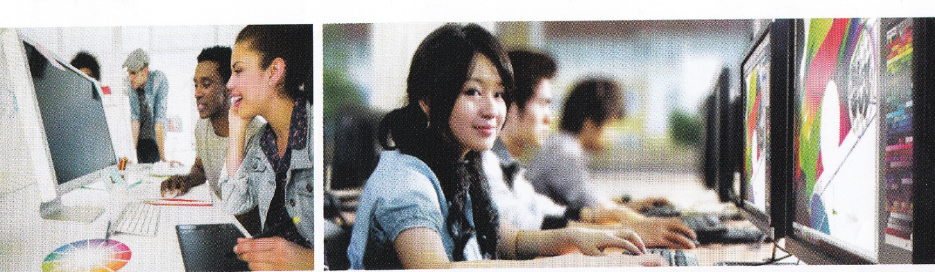
COURSE CODE : DMA
Everybody loves to see animation and enjoy their effects but this multimedia course at DICE, a trusted Multimedia Institute to train you, creates your own animations and many other multimedia effects anybody ever has thought. Our course in multimedia aims to bring out the artistic designer in you who has mastered various software packages in multimedia like modeling, animation and many more. Through this course you are ready to surprise the crowd with astonishing animated creations.
COURSE DESCRIPTION:
Fundamentals of Computer and OS (Operating System)
Adobe Photoshop
CorelDraw
Adobe Illustrator
Adobe in Design
Adobe Flash
Adobe Premiere
Adobe Dreamweaver
Adobe After Effect
3Ds Max

Slide 13
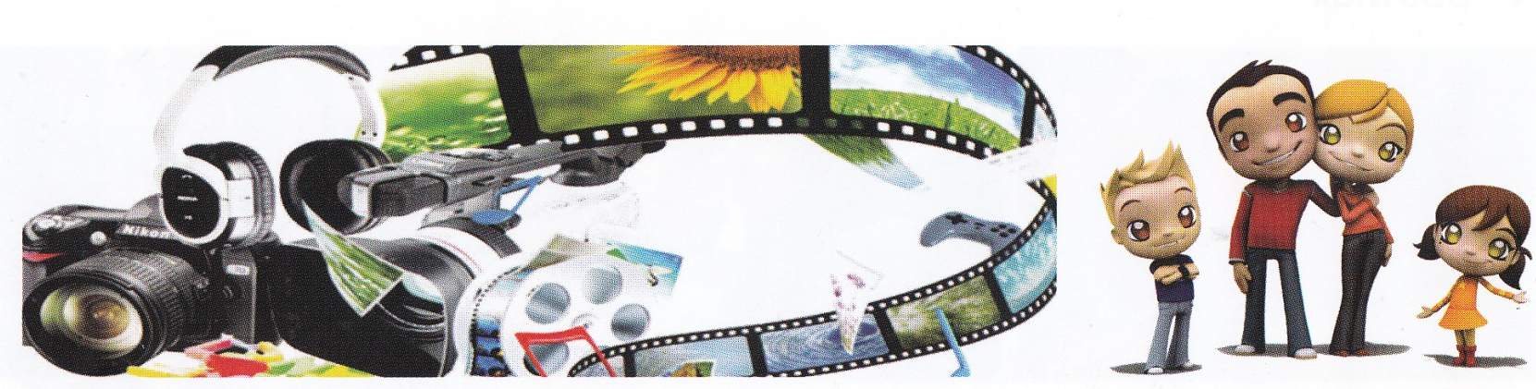
COURSE CODE : ADMA
Advance Diploma in Multimedia Animation is diploma based course. The programme helps to produce full-fledged animation professionals with the skills and confidence to build a rewarding career in the field. The programme will train students in the latest industry relevant modules using technical education tools.
COURSE DESCRIPTION:
Fundamentals of Computer and OS (Operating System)
Internet and different types of Web Browser
HTML, DHTML, CSS (Cascading Style sheet)
Flash and Action Script, Java Script
Dream Weaver
Google Sketchup
2D Animation Post Production
3Ds Max with V – Ray
Adobe Audition
Sound Forge

Slide 14
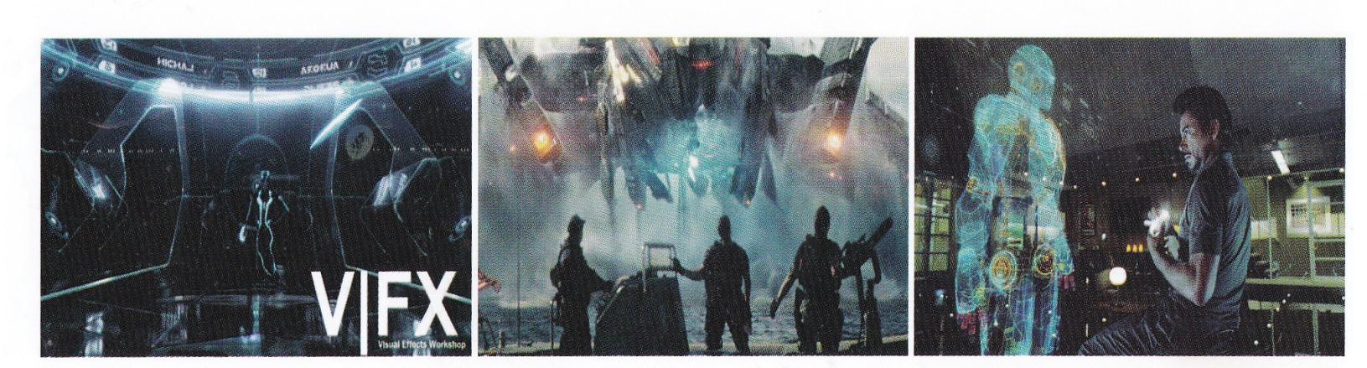
COURSE CODE : VFX
Visual effects today, play a key role in feature films, television programmes, animations, video games, commercial and almost in all forms of entertainment. This fast growing industry demands trained and skilled VFX artists who can work on national and international projects and bring the Director’s vision to life.
COURSE DESCRIPTION
Adobe Photoshop
AutoCAD
Google Sketchup
3Ds Max
Adobe After Effect
Adobe Premier
Sound Forge

Slide 15
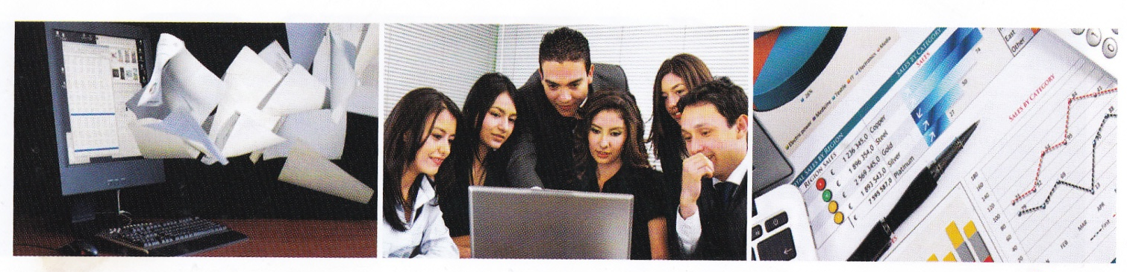
COURSE CODE :DAFA
This Accounts Course trains you in the latest accounting techniques. The curriculum is designed to prepare you for critical challenges and demands of the IT industry. It is suitable for Non-I.T. graduates or undergraduates, and finance or accounts professionals, who want to build a successful career in the corporate sector.
COURSE DESCRIPTION:
Fundamentals of Computer and OS (Operating System)
Ms-Office (Ms-Word, Ms-Excel, Ms-Power Point, Ms-Access)
Internet and Web Browser
Advance Excel
Tally 9.0/ERP 9
  Manual with inventory
  Taxation
  Pay Roll and Excise
Busy Software

Slide 16
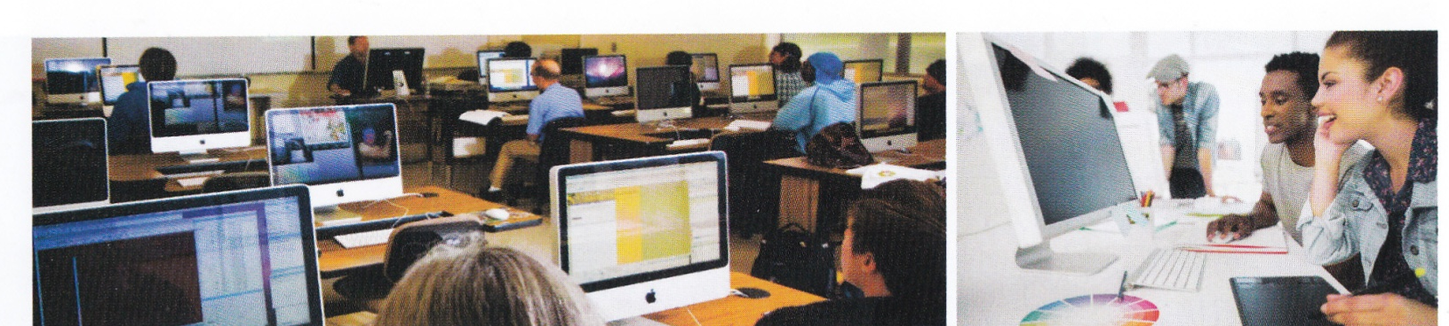
COURSE CODE : DSD
The Diploma in Software Development is most suitable for those wanting to enter the IT industry with the intention of establishing a career in programming or database development capacity.
Aided by strong learning in a number of applications as well as practical simulations in typical work force project teams, this qualification is the perfect spearhead into a full fledged career in programming.
COURSE DESCRIPTION:
Introduction to Information Technology
Programming in C
Programming in C⁺⁺
Visual Basic
The Internet Exposure to E - Commerce
Project Management
Software Design
Java Script
Python
PHP

Slide 17
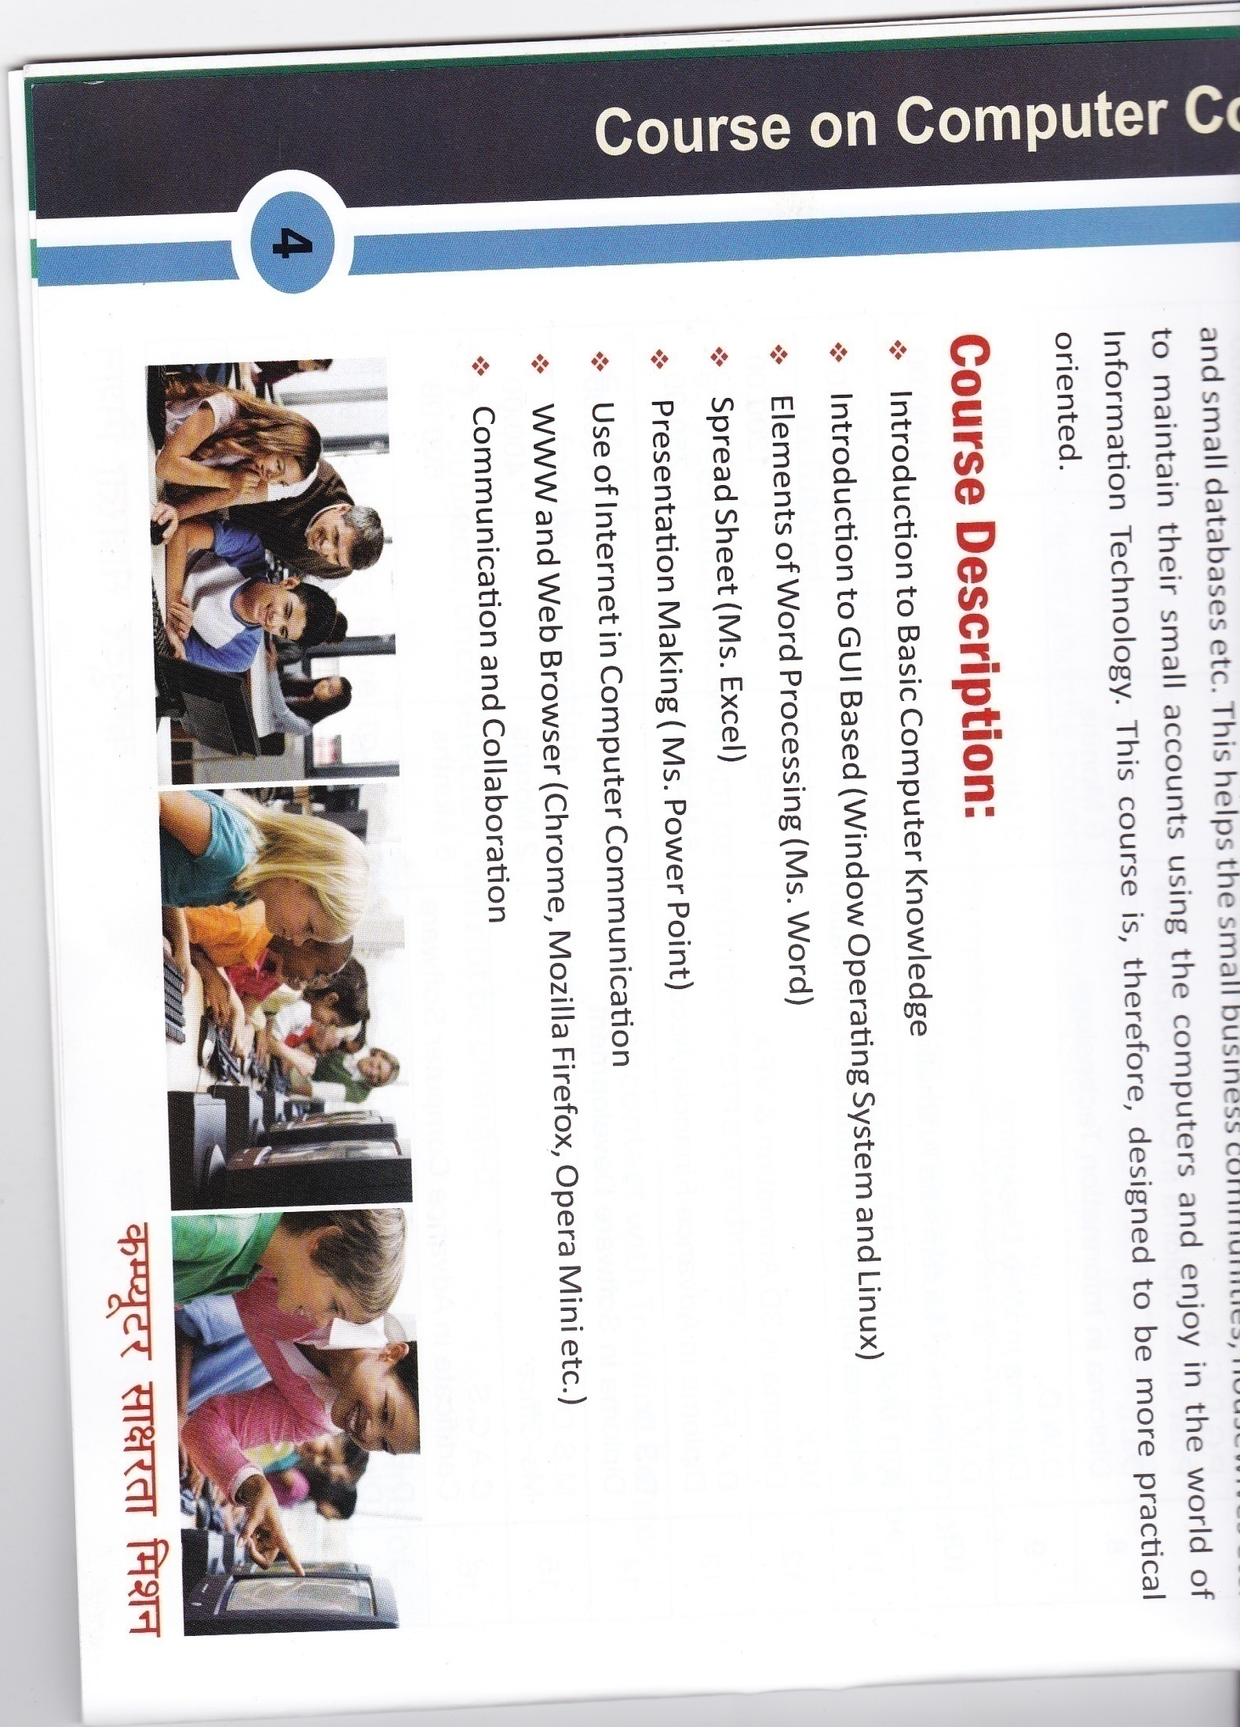
COURSE CODE : MSO
Microsoft office is the gold standard for businesses across the globe. A solid, working knowledge of the various programmers is crucial to success in the working world. In Microsoft Office courses from DICE, you will develop into the specifics of programs such as Microsoft Excel for creating spreadsheets, Microsoft Word for creating documents, Microsoft Share Point for Collaborative projects, Microsoft PowerPoint for presentations and Microsoft Access for database creation and management.
COURSE DESCRIPTION:
Ms-Word
Ms-Excel
Ms-Power Point
Ms-Access
Knowledge of Printing and Scanning

Slide 18
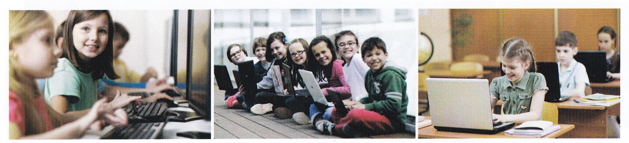
COURSE CODE : CACS
Some community colleges and vocational training institutes offer certificates programs in computer software for those interested in learning to use basic office or Administrative Software. These programmes provides Basic Training in Software Applications, such as Spreadsheets (Ms-Excel), Word Processing (Ms-Word), Database Software (Ms-Access) and Presentation Software (Ms-Power Point). Students learn to use the latest standard industry Software packages through hands on training.
COURSE DESCRIPTION:
Fundamentals of Computer
Ms-DOS
Windows
Ms-Office (Ms-Word, Ms-Excel, Ms-Power Point, Ms-Access)
C, C++ Language Course
Internet and Web Browsing

Slide 19
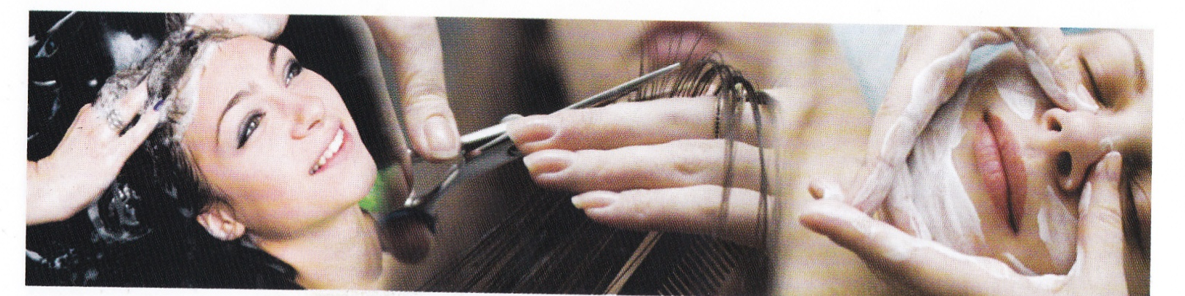
COURSE CODE : DBT
The Courses related to the study as well as application of different kinds of beauty treatments are commonly called beautician courses. This is even known by the name of Cosmetology. This has got several specialized branches like, Cosmetics, Electrology, Hair colouring, Hair styling, Manicures and pedicures, Skin care etc.
COURSE DESCRIPTION:
Threading, pedicure, Manicure, Bleaching, Waxing
Facial, Face Pack, Face Pack Theory, Peeling, Scrub
Simple Makeup, Light makeup, Engagement makeup, Stage
Hair Treatment, Heena, Dye, Dandruff Treatment, Roller Setting
Hair Styles
Saree Wearing and Draping
Cutting, Bridal make up
Mehandi Design
Eye treatments
Apply knowledge of nail science to nail services
Apply knowledge of skin biology to beauty treatments

Slide 20
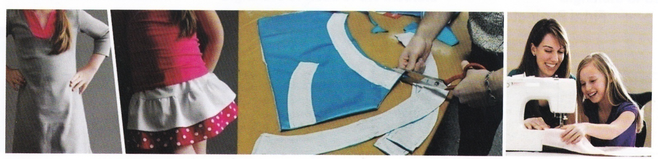
COURSE CODE : DCT
This course is designed to teach the various kinds of pattern making and fashion dress designing in a comprehensive manner. The patterns cater to both standard measurements and personal. By learning different types of patters, a student would be able to stylishly design her own dress according to the latest trends.
This course is useful for person who wish to start their own business such as establishing a tailoring unit or a Boutique as well as for Professional garment design opportunities in the industry.
COURSE DESCRIPTION:
Basic Knowledge of Stitching
Dress Measurements and Techniques
Cutting and Tailoring Ideas
Methods to Fold the Fabric for Patterns
Tailor Ladies Wear
Tailor Gents Wear
Practical

Slide 21
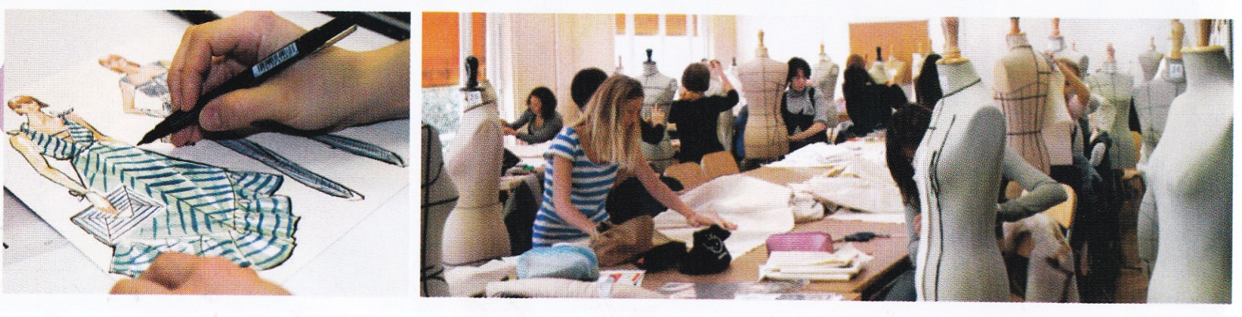
COURSE CODE : DFD
This one year Diploma programme in Fashion designing and clothing Technology emphasizes on practical industry oriented training. This intensive design and technical programme emphasizes on the detailed knowledge of the subject backed by research and theamatic working. The basics of all the subjects are imparted as compulsory training to enable a student to be at ease in all the departments of the industry whereas the specification is offered in the areas of interest. The Fashion designing course aims at placing the students in high professional level in the export as well as Domestic market.
COURSE DESCRIPTION:
History of Fashion Designing
Basic Design
Sketching
Fabric Study
Garment Construction
Fashion Draft and Sketching
Design Idea
Textile
Embroidery
Pattern Making
Drafting
Final Project

Slide 22
DIGITAL INSTITUTE OF COMPUTER EDUCATION (DICE)
Digital Institute of Computer Education (DICE) is an all over India Project Plan
Job oriented and self employed courses
Reasonable Franchise fee
An ISO 9001-2008 certified
Students can check their details and result on website
DICE provides nineteen different courses

Slide 23
THANKING YOU

